Slide 1

Sukhan Lee and Jack C. Pan
Paper Presented by Sony Seng

Slide 2

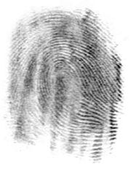
Biometric Systems
  Biometrics is the technology for individual identification based on behavioral and physiological characteristics.
Fingerprint used for identification.

Slide 3
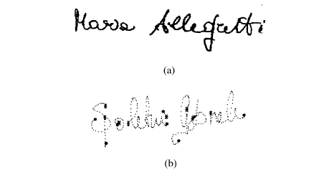
Behavioral Biometrics: Signature Verification and Signature Identification. Uses.
(a) Static and (b) Dynamic signatures. [2]

Slide 4
Why Signatures? The Good and the Bad.
  Bad:
    Signatures change over time.
    Signatures change due to emotional state of a person.
    Can sometimes be easy to forge.

Slide 5
Why Signatures? The Good and the Bad.
  Good:
    Signatures are used everywhere.
    Cost.

Slide 6
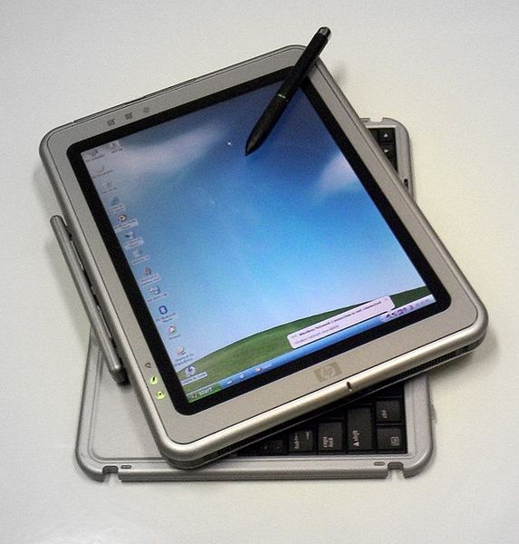
Two general methods of acquiring signatures:
  Online Signature acquisition
    Pen pressure
    Direction
    Velocity
    Acceleration
    Stroke sequence
Tablet PC with Stylus

Slide 7
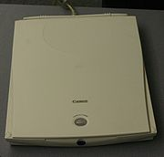
Two general methods of acquiring signatures:
  Offline Signature acquisition
    2D Image of a signature.
Image Scanner

Slide 8
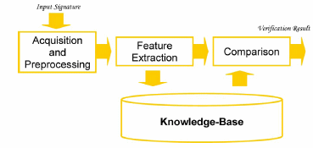
Verifying and Identifying users through their signature.
Process of Signature verification [2]

Slide 9

Lee and Pan develop some heuristics through observations of people tracing signatures [1].
Tracing involves hierarchical decision-making for stroke identification and ordering based on a set of heuristic rules.
Transform a two-dimensional spatial pattern into a one-dimensional temporal pattern, making it possible to extract the dynamic features of a signature.

Slide 10

Preprocessing
Tracing
Critical Point Segmentation and Normalization

Slide 11

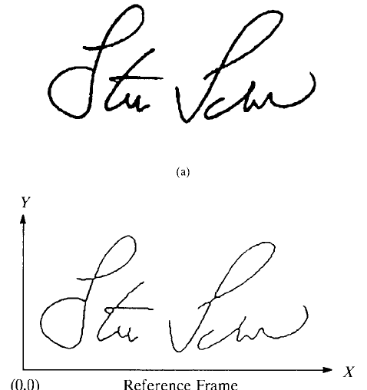
Transform into a binary image
  Thresholding.
Thinning
  Get the 1-pixel skeleton of the
  image.
Noise Reduction
Original Image and preprocessed
image at the bottom

Slide 12

Provides easy extraction of static features such as maximum and minimum points, points of inflection, long strokes, and loops.
Facilitates dynamic features such as the direction of each stroke, the number of strokes, and the temporal relationship among strokes.

Slide 13

Transition Function:
  T(P) is designed to assess the connectivity between a point and its eight immediate neighbors.
  Defined as the number of 0 (white) to 1 (black) transitions in the counterclockwise direction.

Slide 14
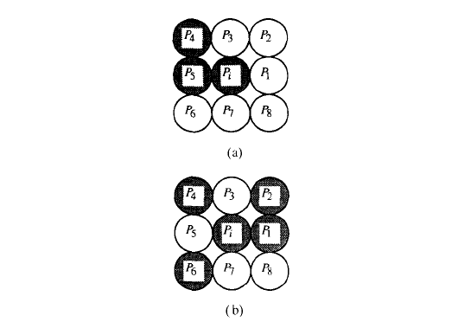
(a) T(p) = 1. (b) T(p) = 3.

Slide 15
End Point (EP): A pixel with T(P) = 1.
Junction Point (JP): A Pixel with T(P) = 3 or T(P) = 4.
Odd JP: Number of branches connected out of the JP are odd.
Even JP: Number of branches connected are even.
Stroke: Begins at an EP or a JP and Ends at an EP or a JP.

Slide 16
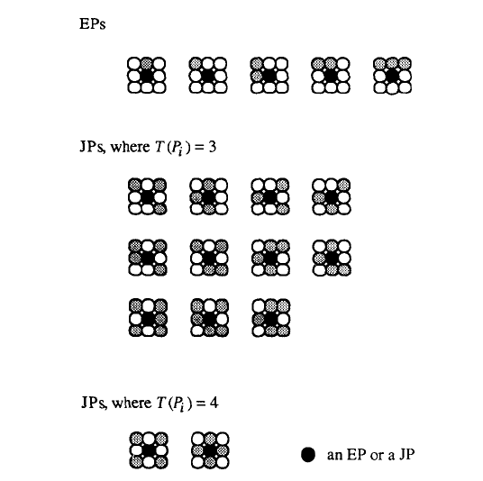
All endpoints and junction points.
5 symmetric endpoints not shown

Slide 17

Tracing between the starting and ending points of a stroke follows a set of heuristic rules.
The process of identifying a stroke by tracing from a starting point to an ending point is repeated until all the strokes embedded in the signature are found.

Slide 18

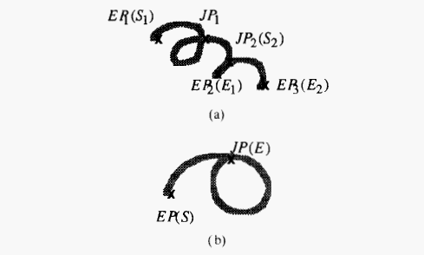
S1 is stroke 1 and S2 is stroke 2 .(b) One Stroke.

Slide 19

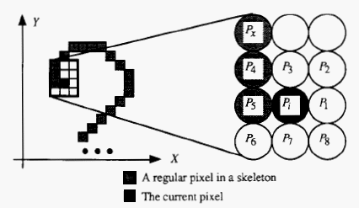
1) Fewer-Untraced-Neighbors-First Rule
  A starting EP may have more than one neighbor. Without any prior tracing history as a reference, the pixel neighbor with fewer untraced neighbors is given higher priority for tracing.
Pick P5 to proceed. P4 has two untraced neighbors

Slide 20
2) Junction-Point-First Rule:
  JP’s play a significant role in determining the connectivity of a signature. During tracing, if one of the immediate neighbors of the current pixel is a JP, the JP is automatically chosen as the next pixel to proceed.

Slide 21
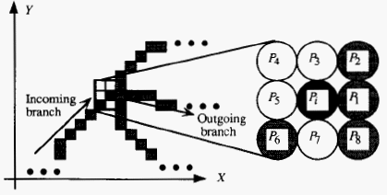
Junction Point First Rule. P1 is taken. If Smoothest first rule,
P2 would have been taken

Slide 22
3) Smoothest-First Rule for an Even JP:
  In the case where a pixel has only one untraced neighbor, tracing proceeds to that untraced pixel. However, in the case where more than one untraced neighbor exists, we need to select an untraced neighbor to proceed based on smoothness of trajectory.
  Find Directional Variation.

Slide 23
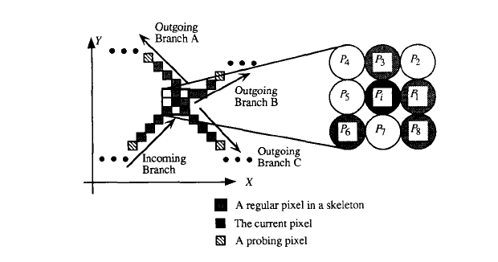
Choose Branch B or P1 as the next pixel trace.

Slide 24
4) Non-Smoothest-first-and-Last Rule for a starting or ending Odd JP:
  A starting Odd JP starts with an outgoing branch that later loops back with an incoming branch and is linked to another outgoing branch.

Slide 25
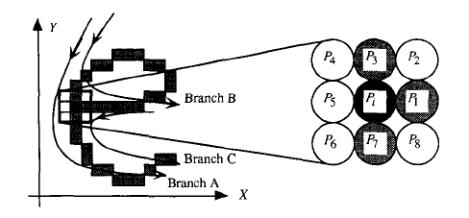
If this is the start of a stroke, take P1 branch B because it is not smooth

Slide 26
5) Backtracing Rule:
  For human handwriting, there are instances there a stroke overwrites its preceding stroke before branching out to become a new stroke. This is usually done to avoid lifting of the pen.
  Occurs when tracing reaches an EP and the last JP of the current tracing has a single untraced branch.

Slide 27
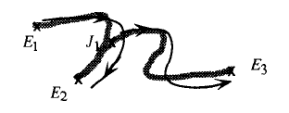
First Stroke at E1 to E2, Backtracing stroke at J1 to E3

Slide 28

6) Intrastroke-Top-Bottom-Left-Right (T-B-L-R) Rule:
  A general observation about human signatures.
  The sequence of a stroke in human and writing normally follows from top to bottom and left to right.
  Serves as a performance measure (PM) for tracing of a stroke. Used to alter the stroke later on.

Slide 29
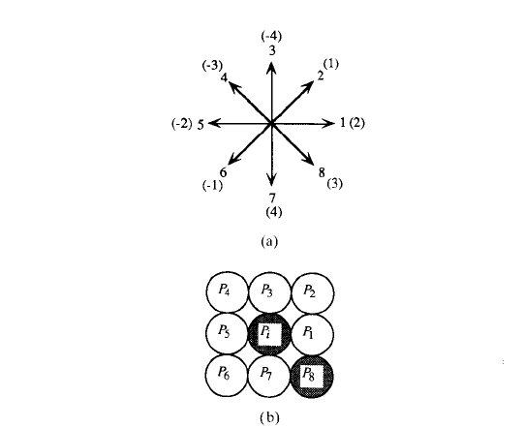
Chain Code choosing the next pixel to trace.
PM for this example is 3

Slide 30
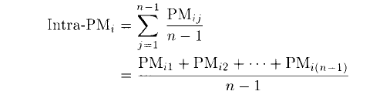
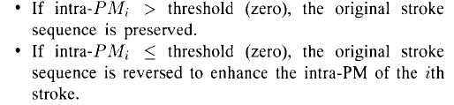

Slide 31
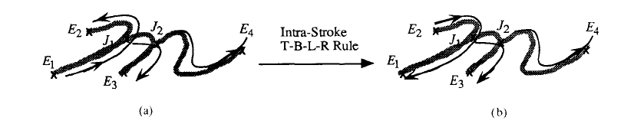
(a) Originally, the algorithm traces from E1 to E2 and sets it as a stroke.
(b) E2 to E1 is reversed Due to Rule 6.

Slide 32
7) Interstroke-Reordering-and-Reversing Rule:
  Reorder the strokes or Reverse the sequence of pixels for a stroke so as to minimize hand movement from one stroke to the next stroke. and consequently resemble the natural writing sequence of a signature.

Slide 33

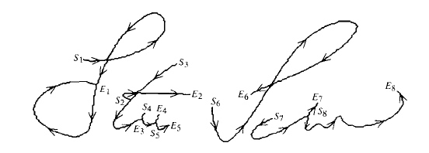
Stroke sequence and stroke pixel sequence recovered.

Slide 34

It has been known that feature points such as maxima, minima, and inflection points of planar curves and 2-D shapes lie in the area where significant variation of curvature occurs.
Can reveal a person’s writing style.
Very Important pieces of information about curves. May be able to reconstruct the signature from a set of critical points.
Reduces amount of data needed to store and match signatures.
Can be used as representation of signatures in a database along with other attributes.
The result of the critical point segmentation method is a sequence of critical points that are ordered according to their tracing sequence and grouped on a stroke-by-stroke basis.

Slide 35
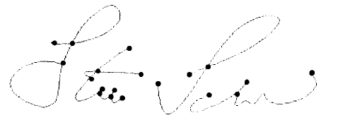
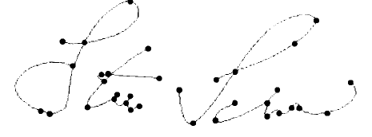
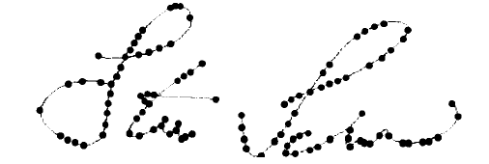

Slide 36

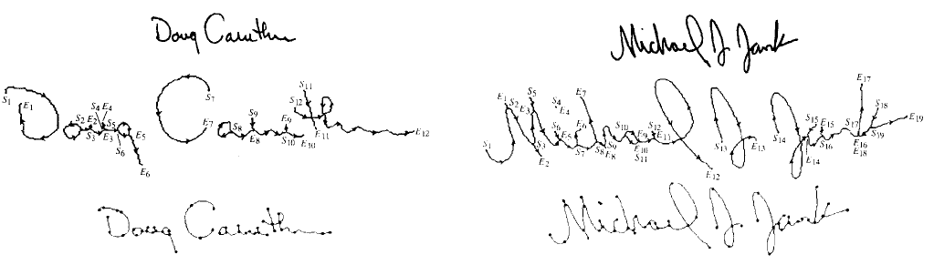
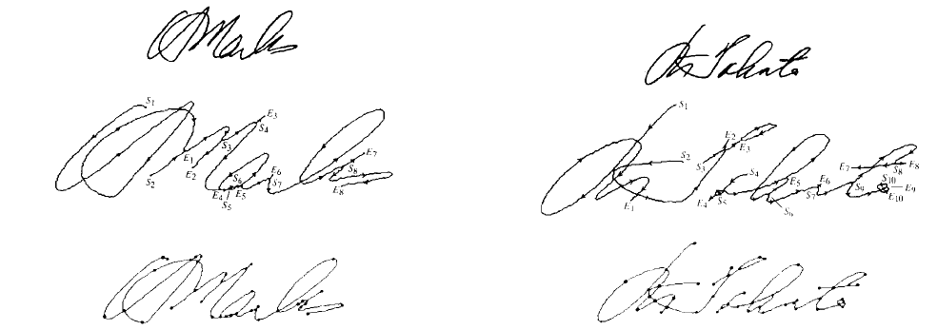
First Row. Original Signature. Second Row Stroke Segmentation. Last Row Critical Point segmentation.
First Row. Original Signature. Second Row Stroke Segmentation. Last Row Critical Point segmentation.

Slide 37

[1] S. Lee and J.C. Pan, “Offline Tracing and Representation of Signatures”, IEEE Trans. On Systems, Man, and Cybernetics, Vol. 22, No. 4, pp. 755-771, 1992
[2] D. Impedovo and G. Pirlo, “Automatic Signature Verification: The State of the Art”, IEEE Trans. On Systems, Man, and Cybernetics, Vol. 38, No. 5, 2008
[3] N. Muralidharan and S. Wunnava, “Signature Verification: A Popular Biometric technology”, Second LACCEI International Latin American and Caribbean Conference for Engineering and Technology, 2-4 June 2004, Miami, Florida, USA

